Slide 1

Twitter Interface
Ngô Sỹ Tùng Lâm
Trần Trọng Khánh
Tô Minh Sơn

Slide 2

Contents
Introduction
Architecture
Activities
Demo
Conclusion

Slide 3
Introduction - Twitter
Definition: a social networking and microblogging service.
Task: allows users to answer the question, "What are you doing?“.
Method: sending short text messages 140 characters in length, called "tweets", to users friends, or "followers."

Slide 4
Introduction – Group project
What are we going to do:
A simple twitter interface
User can log in
User can visit home
User can see notifications
User can see private messages

Slide 5
Architecture
2 main activities:
Login activity
Twitter activity

Slide 6
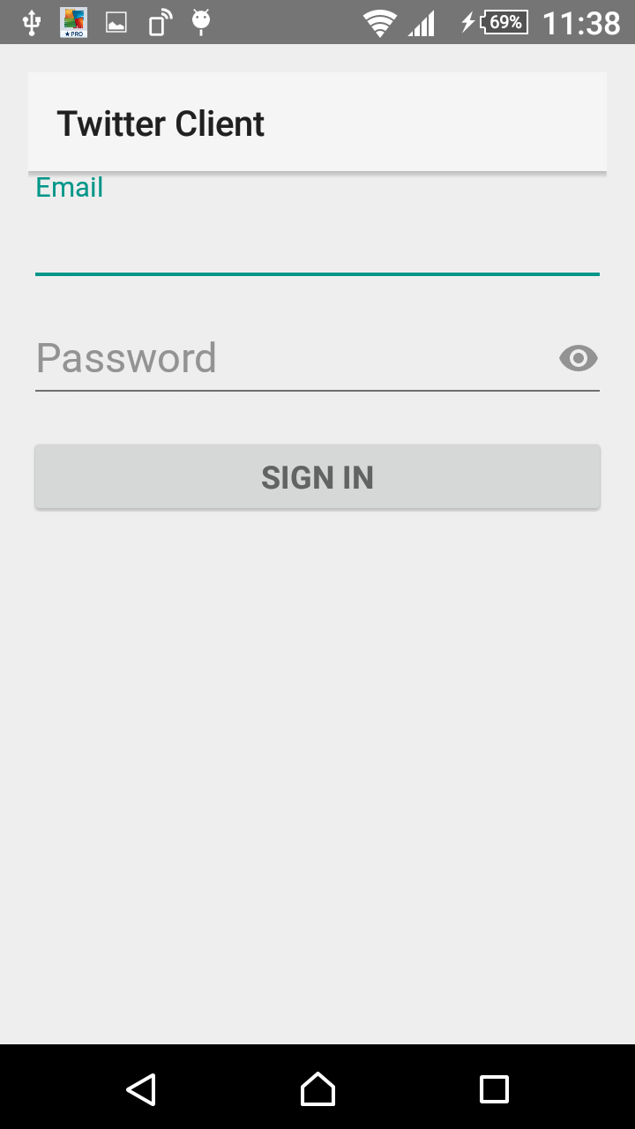
Log In Activity
An user logging in
2 inputs:
Email
Password

Slide 7
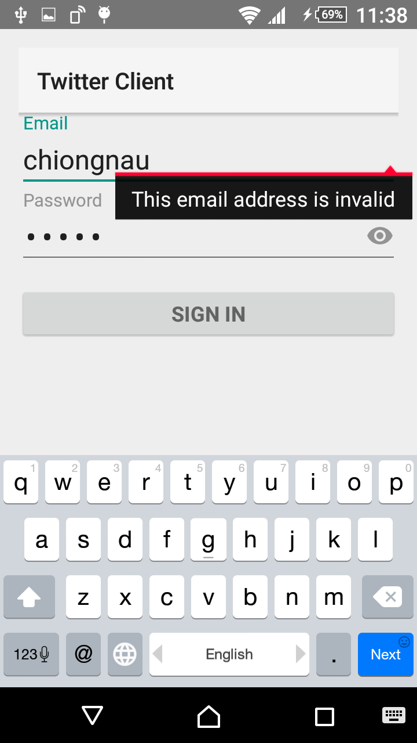
Log in requirements
Email and password required
Valid email form
Password Length > 4 letters

Slide 8
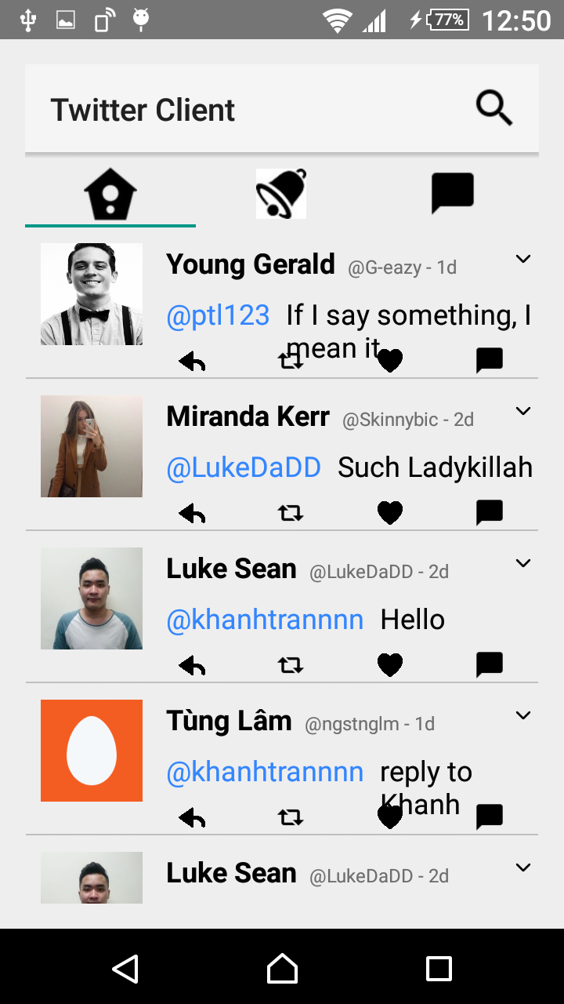
Twitter Activity – Homes
Show the most recent tweets of your following users
4 basic functions:
Reply
Retweet
Like
Talk privacy

Slide 9
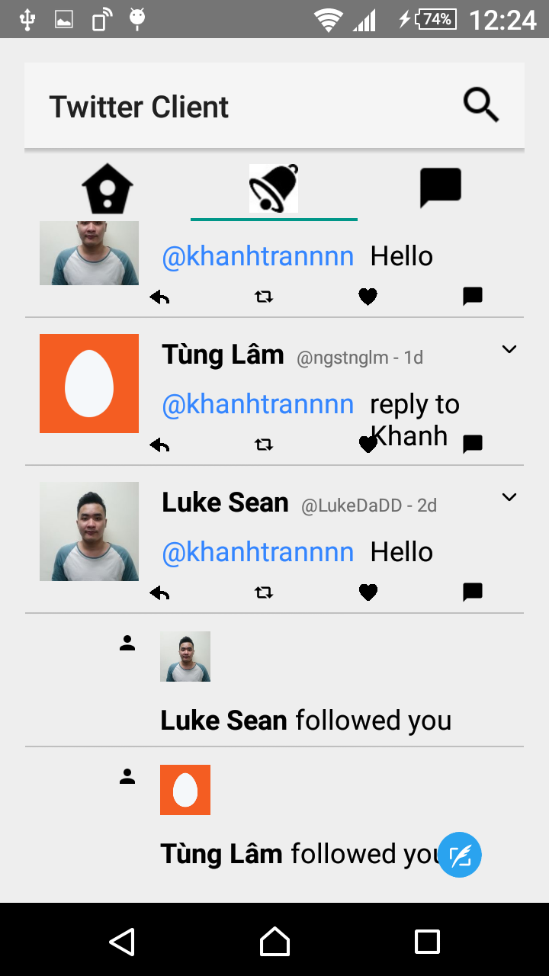
Twitter Activity - Notification
Show tweet, new follows that are related to current user

Slide 10
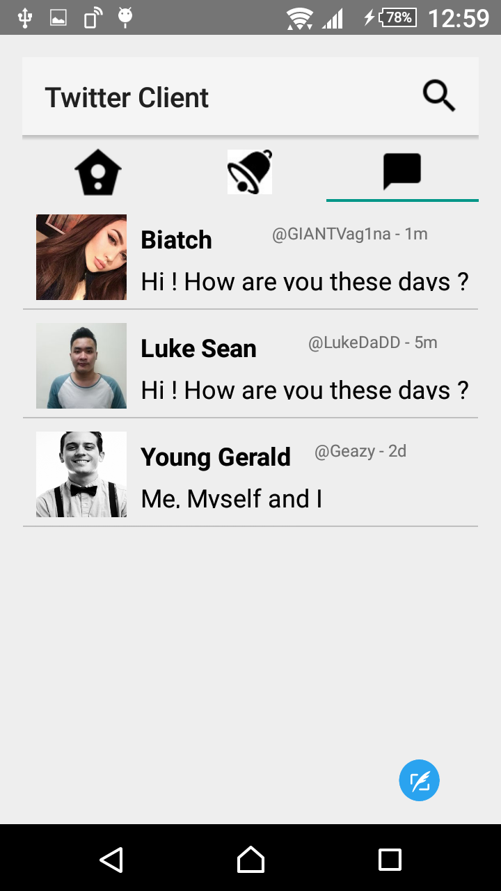
Twitter Activity - Message
Show private messages of current user with other users

Slide 11
Demo Time

Slide 12
Conclusion
What we have done:
A Simple twitter interface with 2 activies:
Login activity
Twitter Activities
Things to improve:
Performance optimization
More complex task

Slide 13
Thank you for listening!

